Slide 1
Summer 2023 Preparing to Pay for College
Created by Maria Rebecchi | Edited by Trang Tran 5.23
Notes:
Welcome everyone to the Preparing to Pay for College session – how to prepare to pay for college during the summer before your senior year! Being a first-generation college student myself, I know how confusing and stressful financial aid can be. I remember worrying so much during my senior year if I would have enough to pay for college. Luckily, this presentation is the first of many financial aid presentations we have available for you to help you understand and have the tools and knowledge to better understand financial aid. We know here at CSF that learning financial aid can be like learning a new language, but we are here for you to help decode a decipher all things financial aid so that when springtime comes around, you are confident in the school that you have selected to attend next year.

Slide 2
Post-High School Planning
What paths are you considering after high school?
How can you make best use of your summer to prepare for the road ahead?

Slide 3
Post-High School Planning
Apprenticeship
Trade School
2-Year Community College
4-Year College/University
Did you know financial aid can help pay for these various pathways?
Now is the perfect time to start preparing!

Slide 4
Objectives: Ways you can get a head start!
Research Pathways
- Make your list
- Look at cost
Financing your Education
- FAFSA/WASFA
- Scholarships
Create a calendar of VIP dates
Notes:
These are ways that you can begin to prepare this summer to finance your education. I'll break down why each of these are important in the next few slides.

Slide 5
Research Pathways
Notes:
How many of you have begun to

Slide 6
Researching Pathways
What are important factors when researching options after high school?
Notes:
Pose to the group:
What are important factors to consider when researching options after high school?
Some potential ideas are:
Majors – does the school have the programs you're interested in?
Student services – does the school have the resources you need to succeed?
Location – where do you want to go to school?
We want to add a few additional items to consider to your research that are related to financial aid.

Slide 7
Make your List!
Why is it important to give yourself plenty of options?
Not all financial aid offers are created the same – set yourself up to find the most affordable offer!
Use other financial aid offers as bargaining tools to ask for more aid
Don't forget to research financial aid priority deadlines!
Notes:
Now, the summer is an important time to start making your college lists. Be sure to include a variety of schools, including schools you may get into, and schools you know for a fact you will be admitted to.
This is related to financial aid because you want to apply to a variety of schools to give yourself options. In the winter/spring, the colleges/universities that you have applied to will start sending their financial aid award offers. Not all financial aid offers are created the same, so you want to be sure you apply to several schools so that you can consider the best and most affordable offer. This is how you set yourself up to minimize as much debt as possible. You want to go to a school that offers a robust financial aid package with good financial aid – lots of free aid is the best! So while you may have your heart set on one school, apply to some safety schools just in case. I didn't go to my first choice school, but now I have a manageable amount of debt, I made lifelong friends and I am working a career that I only dreamed about! These are important things to think about
It's also important that you apply a variety of schools on your college list because you can use your financial aid offers as a bargaining tool to ask for additional aid!
Lastly, when you are making your college lists, be sure to research each college/university's financial aid priority deadline. Financial aid is first come first serve, and if you miss the priority deadline, you may lose out on great financial aid opportunities. So be sure to look up your schools financial aid priority deadlines and apply for the FAFSA/WASFA before your school's deadline.

Slide 8
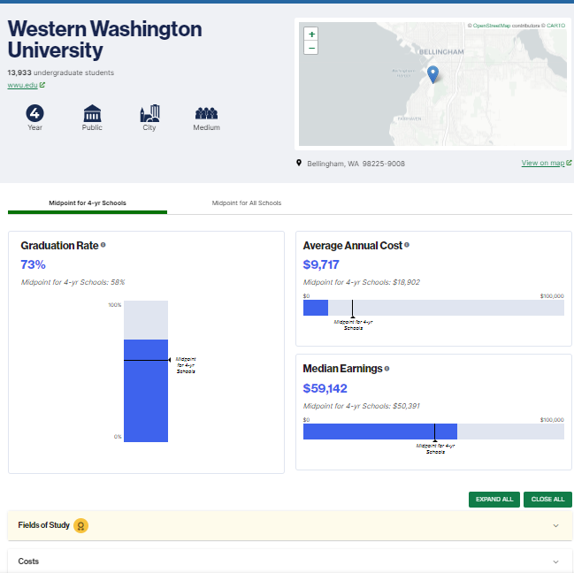
Resource: College ScoreCard
Use College ScoreCard when doing your research on schools
www.collegescorecard.ed.gov/
Compare schools
Explore average cost by family income
Graduation and Retention
Financial aid and debt
Typical earnings
Campus Diversity
Test-scores and acceptance
Notes:
We want to share with you a resource that you can use to research and compare schools: College Score Card.
This is a great resource where you can start getting familiar with how much schools typically cost, and how much students are recieiving in financial aid! This resource even shows you typical earnings post-grad, which can help you get an idea of how students are faring each year.
Remember, this website is just providing a snapshot, and you won't know what you're exact financial aid package will look like until later in the spring of next year. This is just a resource for you if you want to start exploring cost at each school in your research.

Slide 9
Financing Your Education
Notes:
Now, this section will discuss how you can finance your education.

Slide 10
Complete your Financial Aid Application
Starting in December 2023, you can start applying for financial aid for the 2024-2025 school year
Apply either to the FAFSA or WASFA
By applying to these applications, you are signaling to schools you wish to attend you would like to receive financial aid
Notes:
Starting in December 2023, you can start applying for financial aid for funding for next school year by applying to either the FAFSA or the WASFA.
Why apply to the FAFSA or WASFA? This signals to the schools you're thinking of attending that you would like to receive financial aid

Slide 11
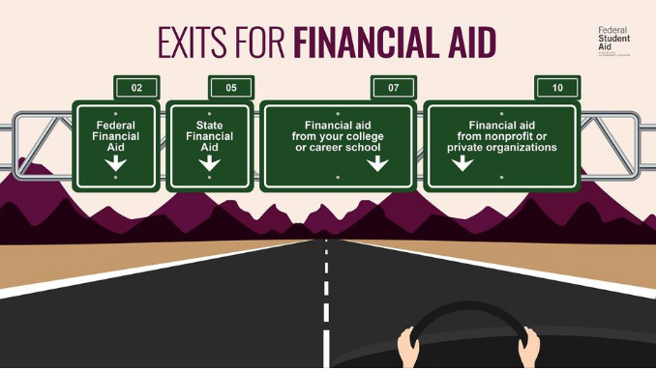
Notes:
By applying to the FAFSA/WASFA, you are applying for different types of federal, state and even institutional aid! Even scholarships from private organizations may require you to file a FAFSA/WASFA.
Remember, for aid from your college or career school or private organizations, there may be additional applications you need to submit to be eligible. Keep that in mind.

Slide 12
TYPES OF FINANCIAL AID
Grants and scholarships are usually based on financial need and don’t have to be repaid.
Loans are an investment in your future…if you borrow only what you need. Remember, they must be paid back with interest.
A work-study job allows you to earn money while you are in school
Notes:
Now, when you're applying for financial aid, keep in mind that not all financial aid work the same way! We want to give you a break down of the different types so you can become familiar with it.
There are three types of Financial Aid.
Free money is money you don’t have to pay back. This can come in the form of grants or scholarships.
Borrowed money is funding that must be repaid with interest. Student loans can be from the federal government, your college, or private banks.
Lastly, there is earned money in the form of work study. Work study is a student employment program where the students earn financial aid by working a job—for instance, working at your college’s library and receiving a paycheck from your financial aid funds.

Slide 13
Apply for Financial Aid: Which application to complete?
FAFSA
U.S. Citizens U.S. Nationals (American Samoa or Swains Islands) U.S. Permanent Residents I-94 Holders : Refugee, Asylum granted, Cuban-Haitian Entrant, Conditional entrant, Parolee Visa Holders under VAWA T or T-1 Visa Holders **** Applies for federal and state aid
WASFA
Undocumented students Students with DACA (expired or not) Other non-citizens** (check w/ individual college/university) Defaulted/balance on federal loans/grants Students who don’t feel comfortable completing the FAFSA Other reasons **** Applies for state aid
OR
Must meet SB 5194* requirements for in-state tuition & in-state financial aid
*Source: https://wsac.wa.gov/wasfa **Other ways to be resident: https://wsac.wa.gov/student-residency
Notes:
The first step to preparing to pay for college is applying for either the FAFSA or the WASFA. Applying for these financial aid applications will indicate to the schools you are applying to that you are interested in receiving financial aid. So this is a very critical step you must do every year you are applying for financial aid. Now, you only apply for one, either the FAFSA or the WASFA, not both!
Students who answer YES to any of these questions are eligible to file a FAFSA
Are you a U.S. Citizen (U.S. National) or one of the following?
U.S. Citizens
U.S. Nationals (American Samoa or Swains Islands)
U.S. Permanent Residents
I-94 Holders : Refugee, Asylum granted, Cuban-Haitian Entrant, Conditional entrant, Parolee
Visa Holders under VAWA
T or T-1 Visa Holders
Filing for a FAFSA means you are applying for federal and state aid.
Washington State offers financial aid programs to students who cannot file, or do not wish to file, a federal FAFSA financial aid application for various reasons:
Immigration status/undocumented
Defaulted federal loans
Repayments owed on federal grants
Unable to provide selective service confirmation
U.S. citizen applicants with undocumented parents/family members who do not wish to file a FAFSA
Transgender students: The FAFSA currently does not account for transgender applicants, or those whose gender does not align with the sex they were assigned at birth. If you are transgender and have not finalized the process of changing your legal name and gender with the Social Security Administration, you may want to complete a WASFA instead. A mismatch between the SSA and FAFSA can complicate the financial aid application or trigger a rejection. Changing name and gender marker may take longer than you expect, so we encourage you to start as early as possible. If you have completed this process, then you should, by all means, complete a FAFSA form.
Applying to the WASFA means you're applying for state financial aid.
To be elligible for state financial aid and in-state tuition, both FAFSA and WASFA filers must meet SB 5194 state residency requirements.
Effective July 25, 2021, the new law, Senate Bill 5194, makes it easier for all Washingtonians, including and especially undocumented students, to meet residency requirements for in-state (resident) tuition and state financial aid.
1.It requires a high school diploma or equivalent without specifying a location.
2. The law now requires that a person must live in Washington for one year, or 12 consecutive months, prior to college admission.
https://wsac.wa.gov/sites/default/files/SB5194OfficalGuidance.pdf

Slide 14
Research scholarship opportunities
Create an account at WashBoard (www.washboard.org) and review scholarship opportunities
Start drafting scholarship essays
Make sure you check with schools regarding their scholarship process:
Are you considered for scholarships when you apply for admissions? What is the deadline?
Is there a separate scholarship application? What is the deadline?
Did you know:
To save $5000 with WA state minimum wages, you must work at least 384+ hours!
Notes:
Now is a really good time to start researching scholarship opportunities and filling your calendar with important scholarship deadlines.
You can start by creating an account on www.theWashBoard.org matches Washington students to scholarships from institutions, local businesses and rotaries, and philanthropists.
Use your free time to start drafting scholarship essays and personal statements that you can use and reuse for other applications
Make sure you check with the college/universities you are applying to regarding their scholarship process. Here are questions that you should ask:
Are you considered for scholarships when you apply for admissions? What is the deadline?
Is there a separate scholarship application? What is the deadline?
Now, I remember when I was applying for scholarships and I just wanted to apply for the big full-ride scholarships. But every dollar counts! I know that $5000 scholarship may not seem much, but comparing that to taking out $20,000 in loans over 4 years, or working 384 hours/ 48 8-hour work days (before taxes). Writing 4 essays over the a few weeks in the summer is a great investment for your time and pockets!!

Slide 15
Research scholarship opportunities
These are great sites to get you started:
www.thewashboard.org
www.collegegreenlight.org
www.waopportunityscholarship.org
https://bigfuture.collegeboard.org/scholarship-search
www.fastweb.com
www.scholarships.com
www.collegeresourcenetwork.com
www.chegg.com/scholarships
www.thedream.us
www.uncf.org
www.hispanicfund.org
https://scholarshipjunkies.org/
www.Gearup.wa.gov
www.unigo.com
Notes:
Here are some additional scholarship search engines – these are uploaded on the CSF financial aid hub if you want to take a look!

Slide 16
Get a summer job and start saving!
You may have a gap that is not covered by financial aid – start preparing now!
Risks of non-payment
Dropped from classes
Hold on transcript
Unable to register for next term
Balance still due
Unpaid balances can go to collections
Notes:
If you have time to spare, we also encourage you to get a job during this summer and next summer and start saving!
You will not know what your financial aid package will look like until next winter/spring. But you may have a gap that is not covered by financial aid (Scholarships, grants, loans, work study)
So you want to start a safety fund in the case you do have a gap. There are risks for non payment – including
Dropped from classes
Hold on transcript
Unable to register for next term
Balance still due
Unpaid balances can go to collections
So, you want to start your safety fund now so that you will not be in this situation.

Slide 17
Calendar of VIP Dates

Slide 18
Creating a calendar of VIP dates
June-July
Start drafting your personal statements.
August-October
FAFSA Filers: Create your own FSA ID for yourself and make sure your parent(s) + step parent create theirs if they have a social security number.
WASFA Filers: Create your own WASFA Account and make sure your parent(s) create theirs.
FAFSA filers w/ parents and step parents w/o social security numbers: create their own FSA ID .
Identify teachers, coaches, supervisors, and others who can write strong letters of recommendation.
Create a list and begin your college admissions applications. Check deadlines!
Seek a teacher or another adult to help proofread admission and scholarship essays.
Create an account at WashBoard (www.washboard.org) and review scholarship opportunities.
Attend at least one virtual college fair and speak to college representatives.
Notes:
Now, here is a calendar of VIP dates/action items for you to consider for the upcoming months.

Slide 19
Creating a calendar of VIP dates
November
December
Wrap up outstanding college applications and meet priority deadlines.
Request your letters of recommendation. Remember to ask your recommender in person and follow-up to ensure they mail it on time; also, provide plenty of time to meet the deadline.
File the 2024-25 FAFSA or WASFA starting December 2023. Use 2022 tax returns.
Continue your scholarship search, both through the college(s) and outside organizations.
Continue applications at colleges that did not have a priority admissions deadline pass.
CSF Scholarship applications open 12/1/23!
Visit www.collegesuccessfoundation.org/our-approach/scholarships/ to learn more and apply!
Notes:
Now, here is a calendar of VIP dates/action items for you to consider for the upcoming months.

Slide 20
Creating a calendar of VIP dates
FAFSA and WASFA open
December 2023
priority deadline
As soon as possible
Tip:
Make sure to check each school’s financial aid office individual deadline.
If you are planning to attend an out-of-state institution, also check that state’s deadline.
Notes:
Q: When do you apply for either the FAFSA or the WASFA?
The FAFSA and the WASFA opens December 2023 and the priority deadline is as soon as possible, but we recommend no later than November 1st.
Again, make sure to check each school's financial aid office's individual deadline, because your school may have a different priority deadline than November 1st. So it's always important to check and mark it in your calendar to ensure you receive financial aid.

Slide 21
Questions? Comments? Help?
Scholarshipservices@collegesuccessfoundation.org

