Slide 1

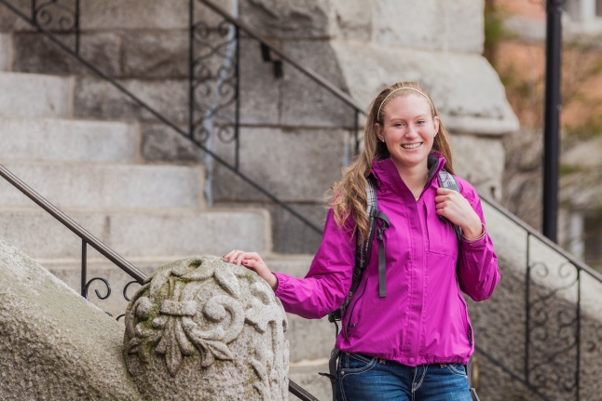
Thank You!
COSTCO EMPLOYEE
SCHOLARSHIP
College/University:
Year in College:
Major:
Dream Job:
Today’s date:
College/University
Year
Major
Job
Date
Dear <enter your donor’s name>,
Thank you so much for your generous donation to help me pay for college! I truly appreciate the financial support that you have provided me in order to accomplish my educational goals. It is because of your support that I can attend the college of my dreams and study communication in the hopes of one day being the marketing director for the Seattle Seahawks!
I am extremely excited for what this new year will be like as I experience college for the first time. I am looking forward to making new friends, taking interesting classes, and hopefully studying abroad while in college.
Again, thank you for allowing me to pursue my dreams. I hope that we can continue to stay in touch throughout my college journey!
Sincerely,
Your Name Here

